Slide 1
Chicago taxi trips
Edwin Kamgang

Slide 2
Chicago taxi trips
Content
Record of Taxi trips reported to the City of Chicago from 2013 to 2019
Trips: 100,000
Features: 23
Source: Data.gov

Slide 3
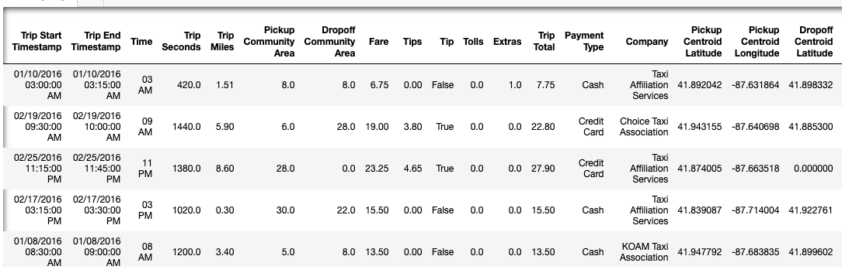

Slide 4
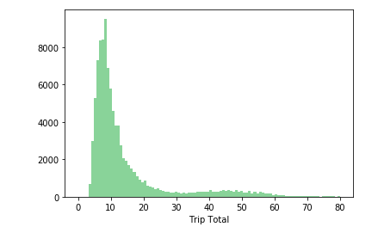
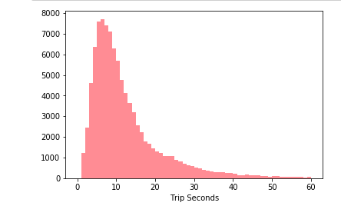
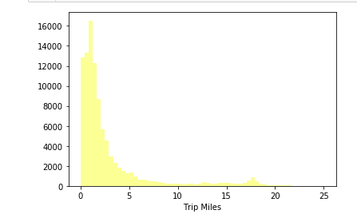

Slide 5
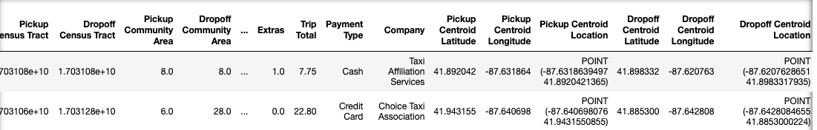
Preprocessing

Slide 6
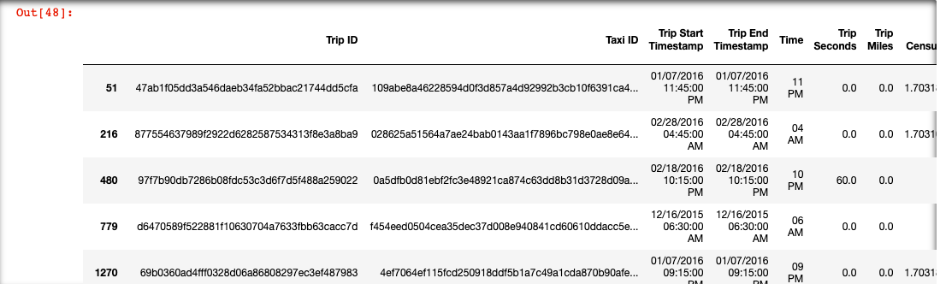

Slide 7
Preprocessing

Slide 8
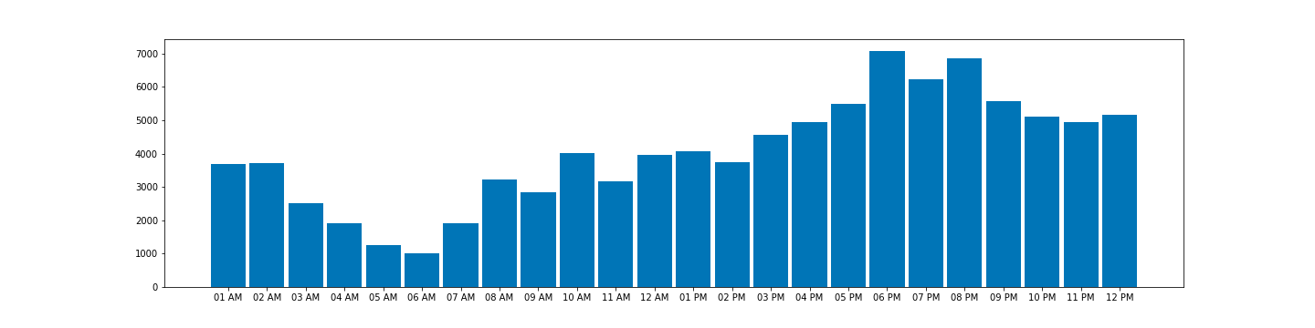
NUMBER OF TAXI TRIP PER HOURS

Slide 9
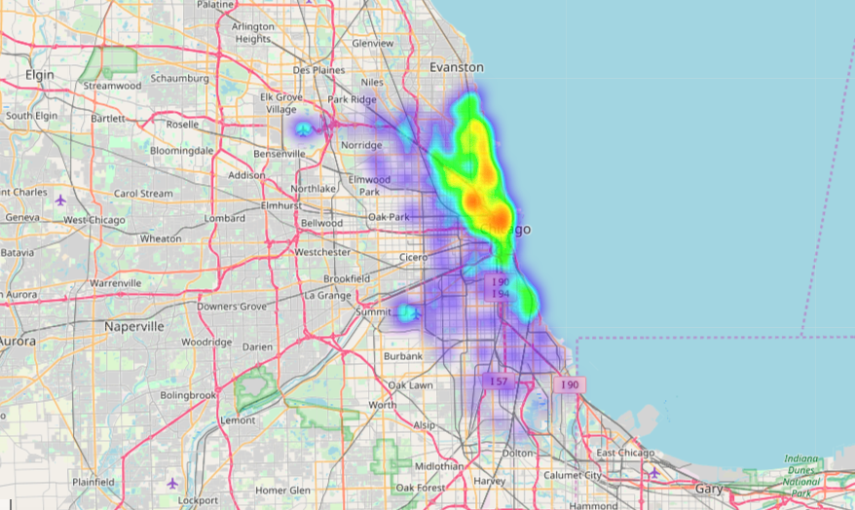

Slide 10
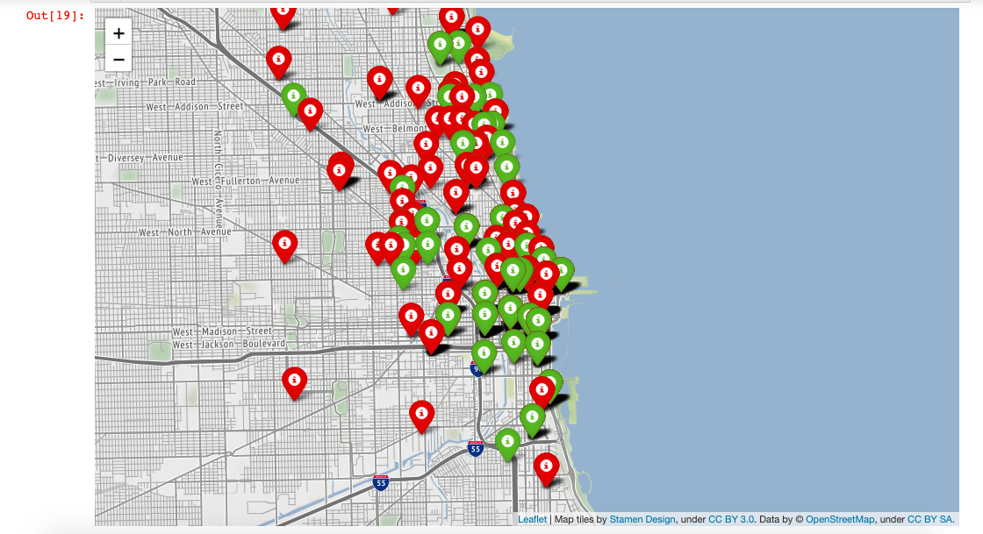
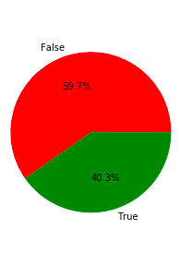
Tips

Slide 11
Logistic regression

Slide 12
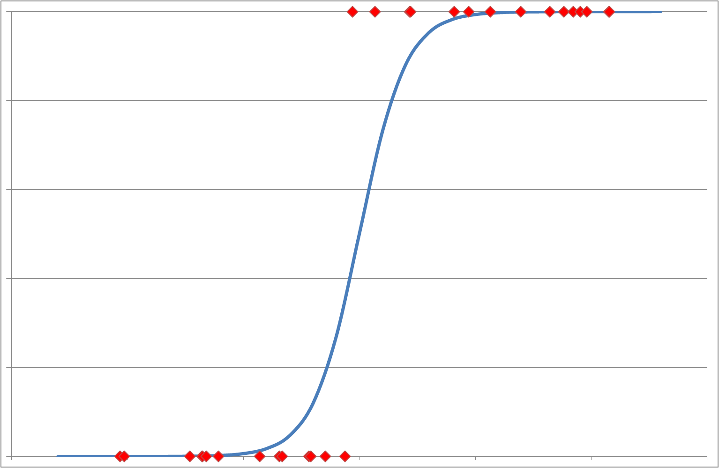
Logistic regression
Goal: predict if a customer will tip or not after a trip
Create dummy target class for tip: true if tip>0, false if tip=0
Features used have a value of correlation with tip>0.3
Fare
Trip Seconds
Trip Miles
Trip Total
Pickup Community Area
Standardization is necessary since all have different units
Accuracy score: 0.8404798232230231
Can it be improved?

Slide 13
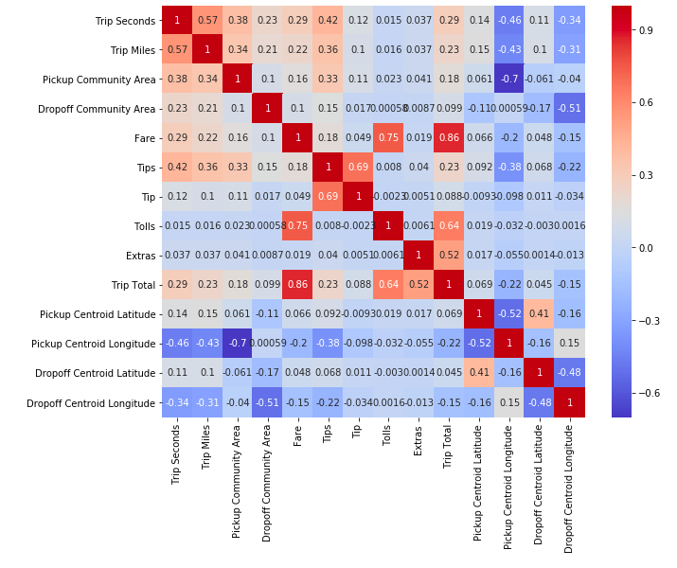
Correlation

Slide 14
Multiple Linear Regression

Slide 15
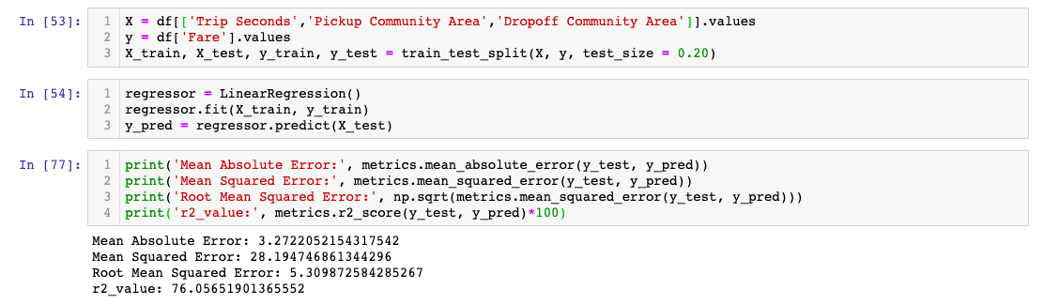
Multiple Linear Regression
Goal: predict the fare of taxi trip

Slide 16
Clustering

Slide 17
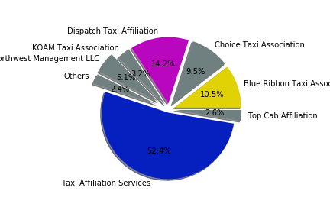
Clustering
Goal:Cluster trips based on the most dominant taxi companies
Method:K-means clustering

Slide 18
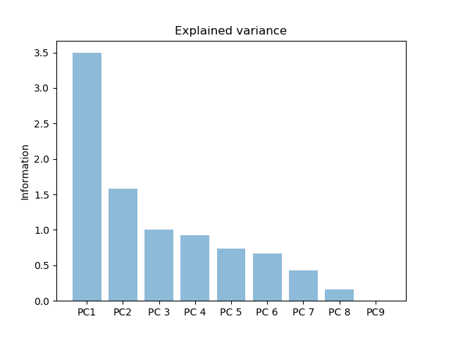
PCA analysis
To make visualization easier and speed machine learning algorithm

Slide 19
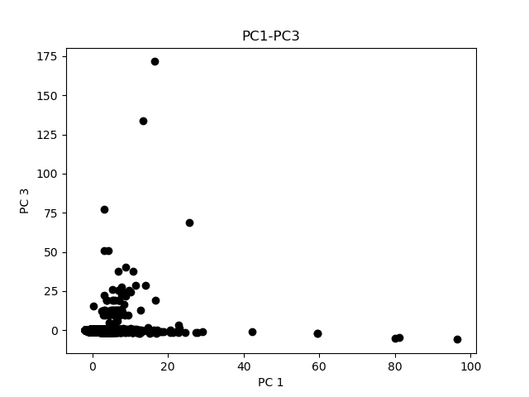
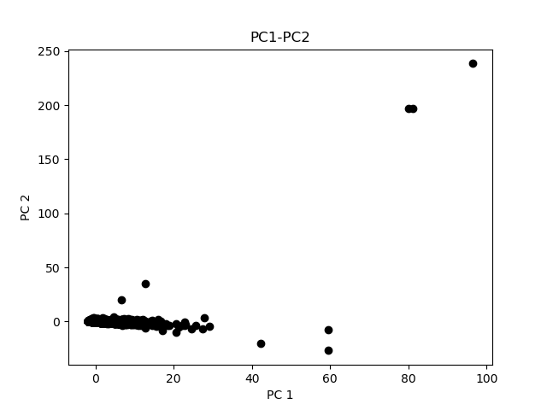
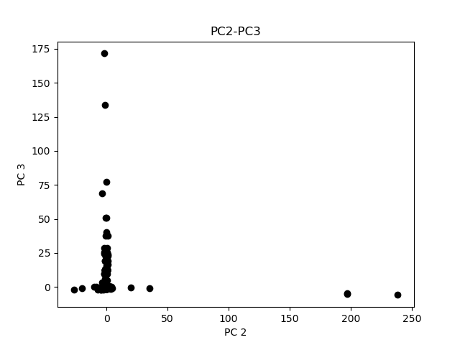

Slide 20
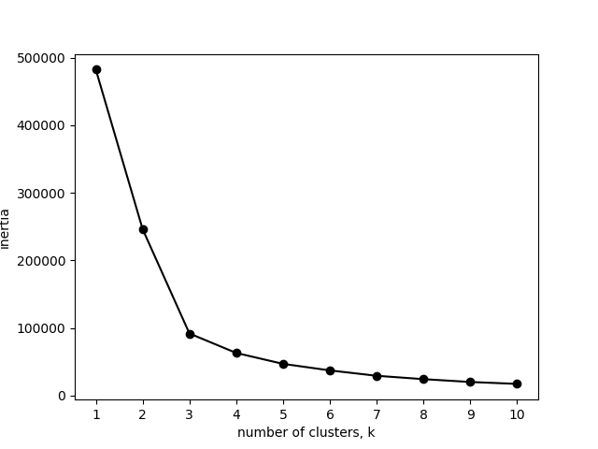
inertia graph

Slide 21
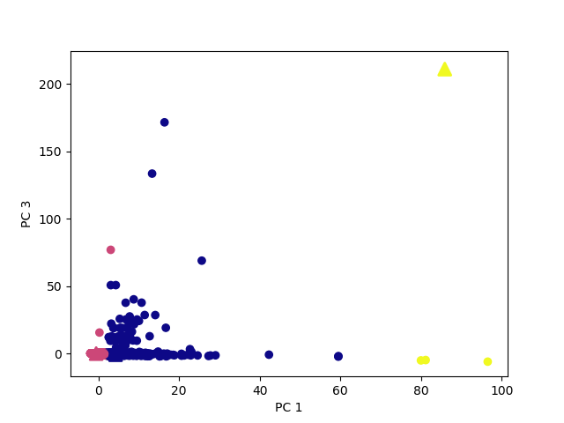
Results

Slide 22
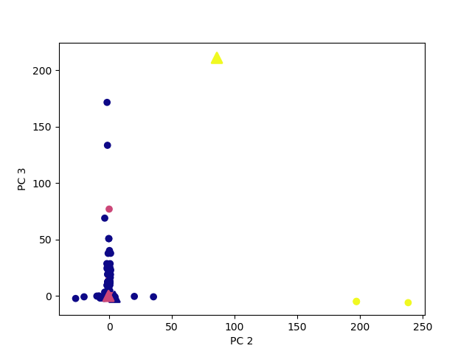

Slide 23
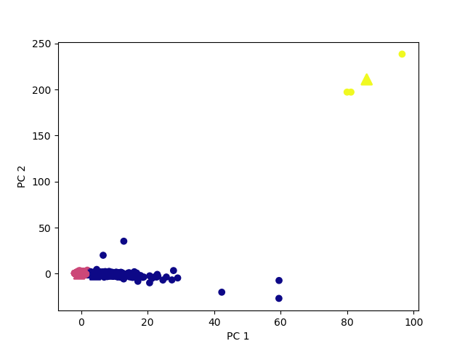

Slide 24
Conclusion
Through data visualization it is possible to identify underlying pattern in the data
Using data mining techniques it is possible to predict with a high accuracy the likelyhood of a customer paying a tip based
most of features in this dataset are not necessary for data prediction.

